Slide 1
Gas-Shutoff Sensor Project Proposal
Sponsor: Wesam Khalil advisor: dr. melinda holtzman
Noah Harvey - Alec Wiese - Kam RobertsoN - Arsalan Sabet
Notes:
Noah

Slide 2
Agenda
Problem Statement
Project Objective
Methodology for Implementation
Design Phase
Implementation Phase
Testing Phase
Evaluation Phase
Project Schedule Plan
Current Project Progress
Notes:
Noah

Slide 3
Problem Statement
Methane, more formally known as Natural Gas, can leak from home appliances and hidden gas lines which presents dangerous and potentially deadly environments to the inhabitants of the home.
Notes:
Noah

Slide 4
Project Objective
The objective of the project is to create a device that turns off the flow of Natural Gas to the home when a leak from a home appliance or gas line is detected in the air.
Notes:
Arsalan

Slide 5
Methodology for Implementation
Design Phase
Gas Sensor provides methane density limit detection (MQ-2)
Microcontroller to receive gas sensor signal & commands shut-off actuator (PIC12F675)
Wireless simplex transmission (315MHz or 433MHz)
Wireless transmission encoder and decoder (PT2262/72)
Detector in standard single gang in-wall junction box with cover plate
Notes:
Kam

Slide 6
Methodology for Implementation
Implementation Phase
Prototype design and assembly
Detector schematic creation and bill-of-materials (BOM) generation
Detector and Actuator Printed Circuit Board (PCB) layout and manufacturer order
Board assembly
Refine PCB and adjust BOM (if needed)
Notes:
Alec

Slide 7
Methodology for Implementation
Testing Phase
Prototype
Detector characteristics and limits
Microcontroller programming
Wireless transmission integrity
Power supply stability
Actuator functionality
PCB
Detector and Actuator board and component fitment
Wireless transmission
Gas detection and actuator performance
Junction box
Notes:
Arsalan

Slide 8
Methodology for Implementation
Evaluation Phase
Out-of-limit state validation
System functionality as a complete unit
Actuator response
System ease of reproduction
Critical System Refinement
Notes:
Noah

Slide 9
Project Schedule Plan
Researching established market options One Week
Designing prototype Two Weeks
Purchasing prototype materials One Week
Analyzing component datasheets One Week
Writing functional code Two Weeks
Testing & debugging prototype Two Weeks
Creating schematic and PCB layout One Week
Purchasing PCB components One Week
Assembling PCB’s One Week
Testing code with PCB Two Weeks
Written Report and Presentation Preparation Two Weeks
Notes:
Alec

Slide 10
Current Project Progress
Prototype
Gas Detection (Butane) Successful
Wireless Transmission – Questionable Signal Integrity
Microcontroller
Written in Assembly Language – Move to C Language
Utilization expansion to wireless encoding
Actuator is simulated using relay device
Battery power is not enough to actuate a small solenoid
Notes:
Kam

Slide 11
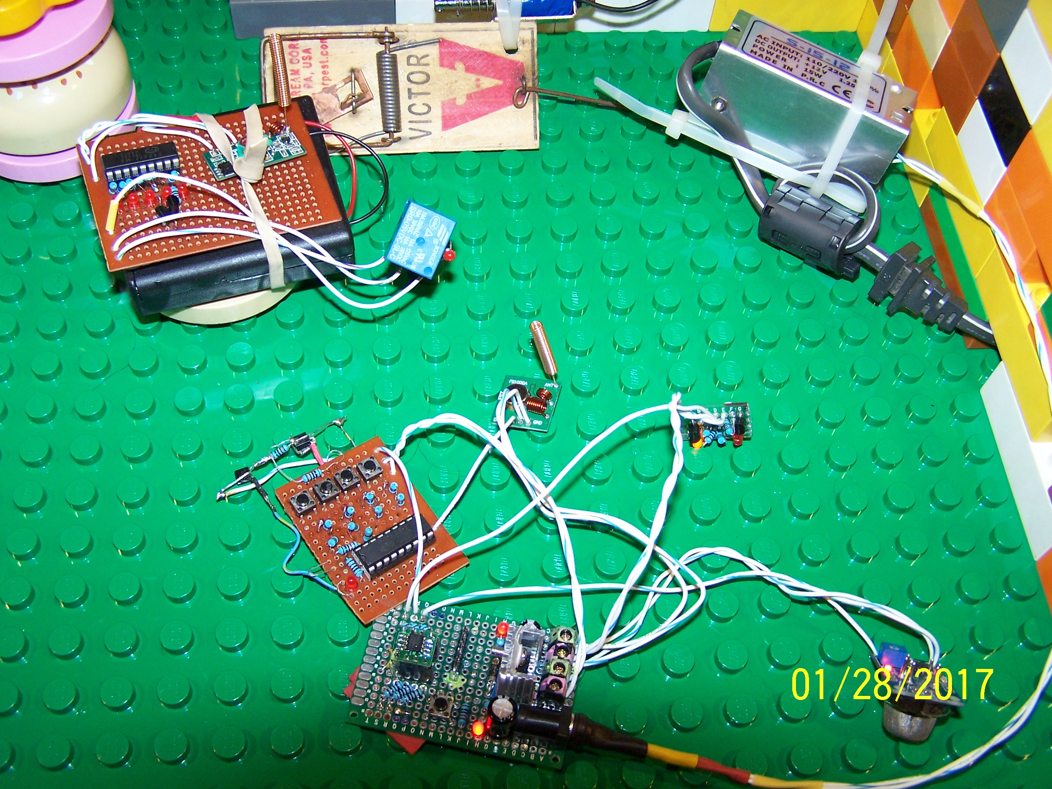
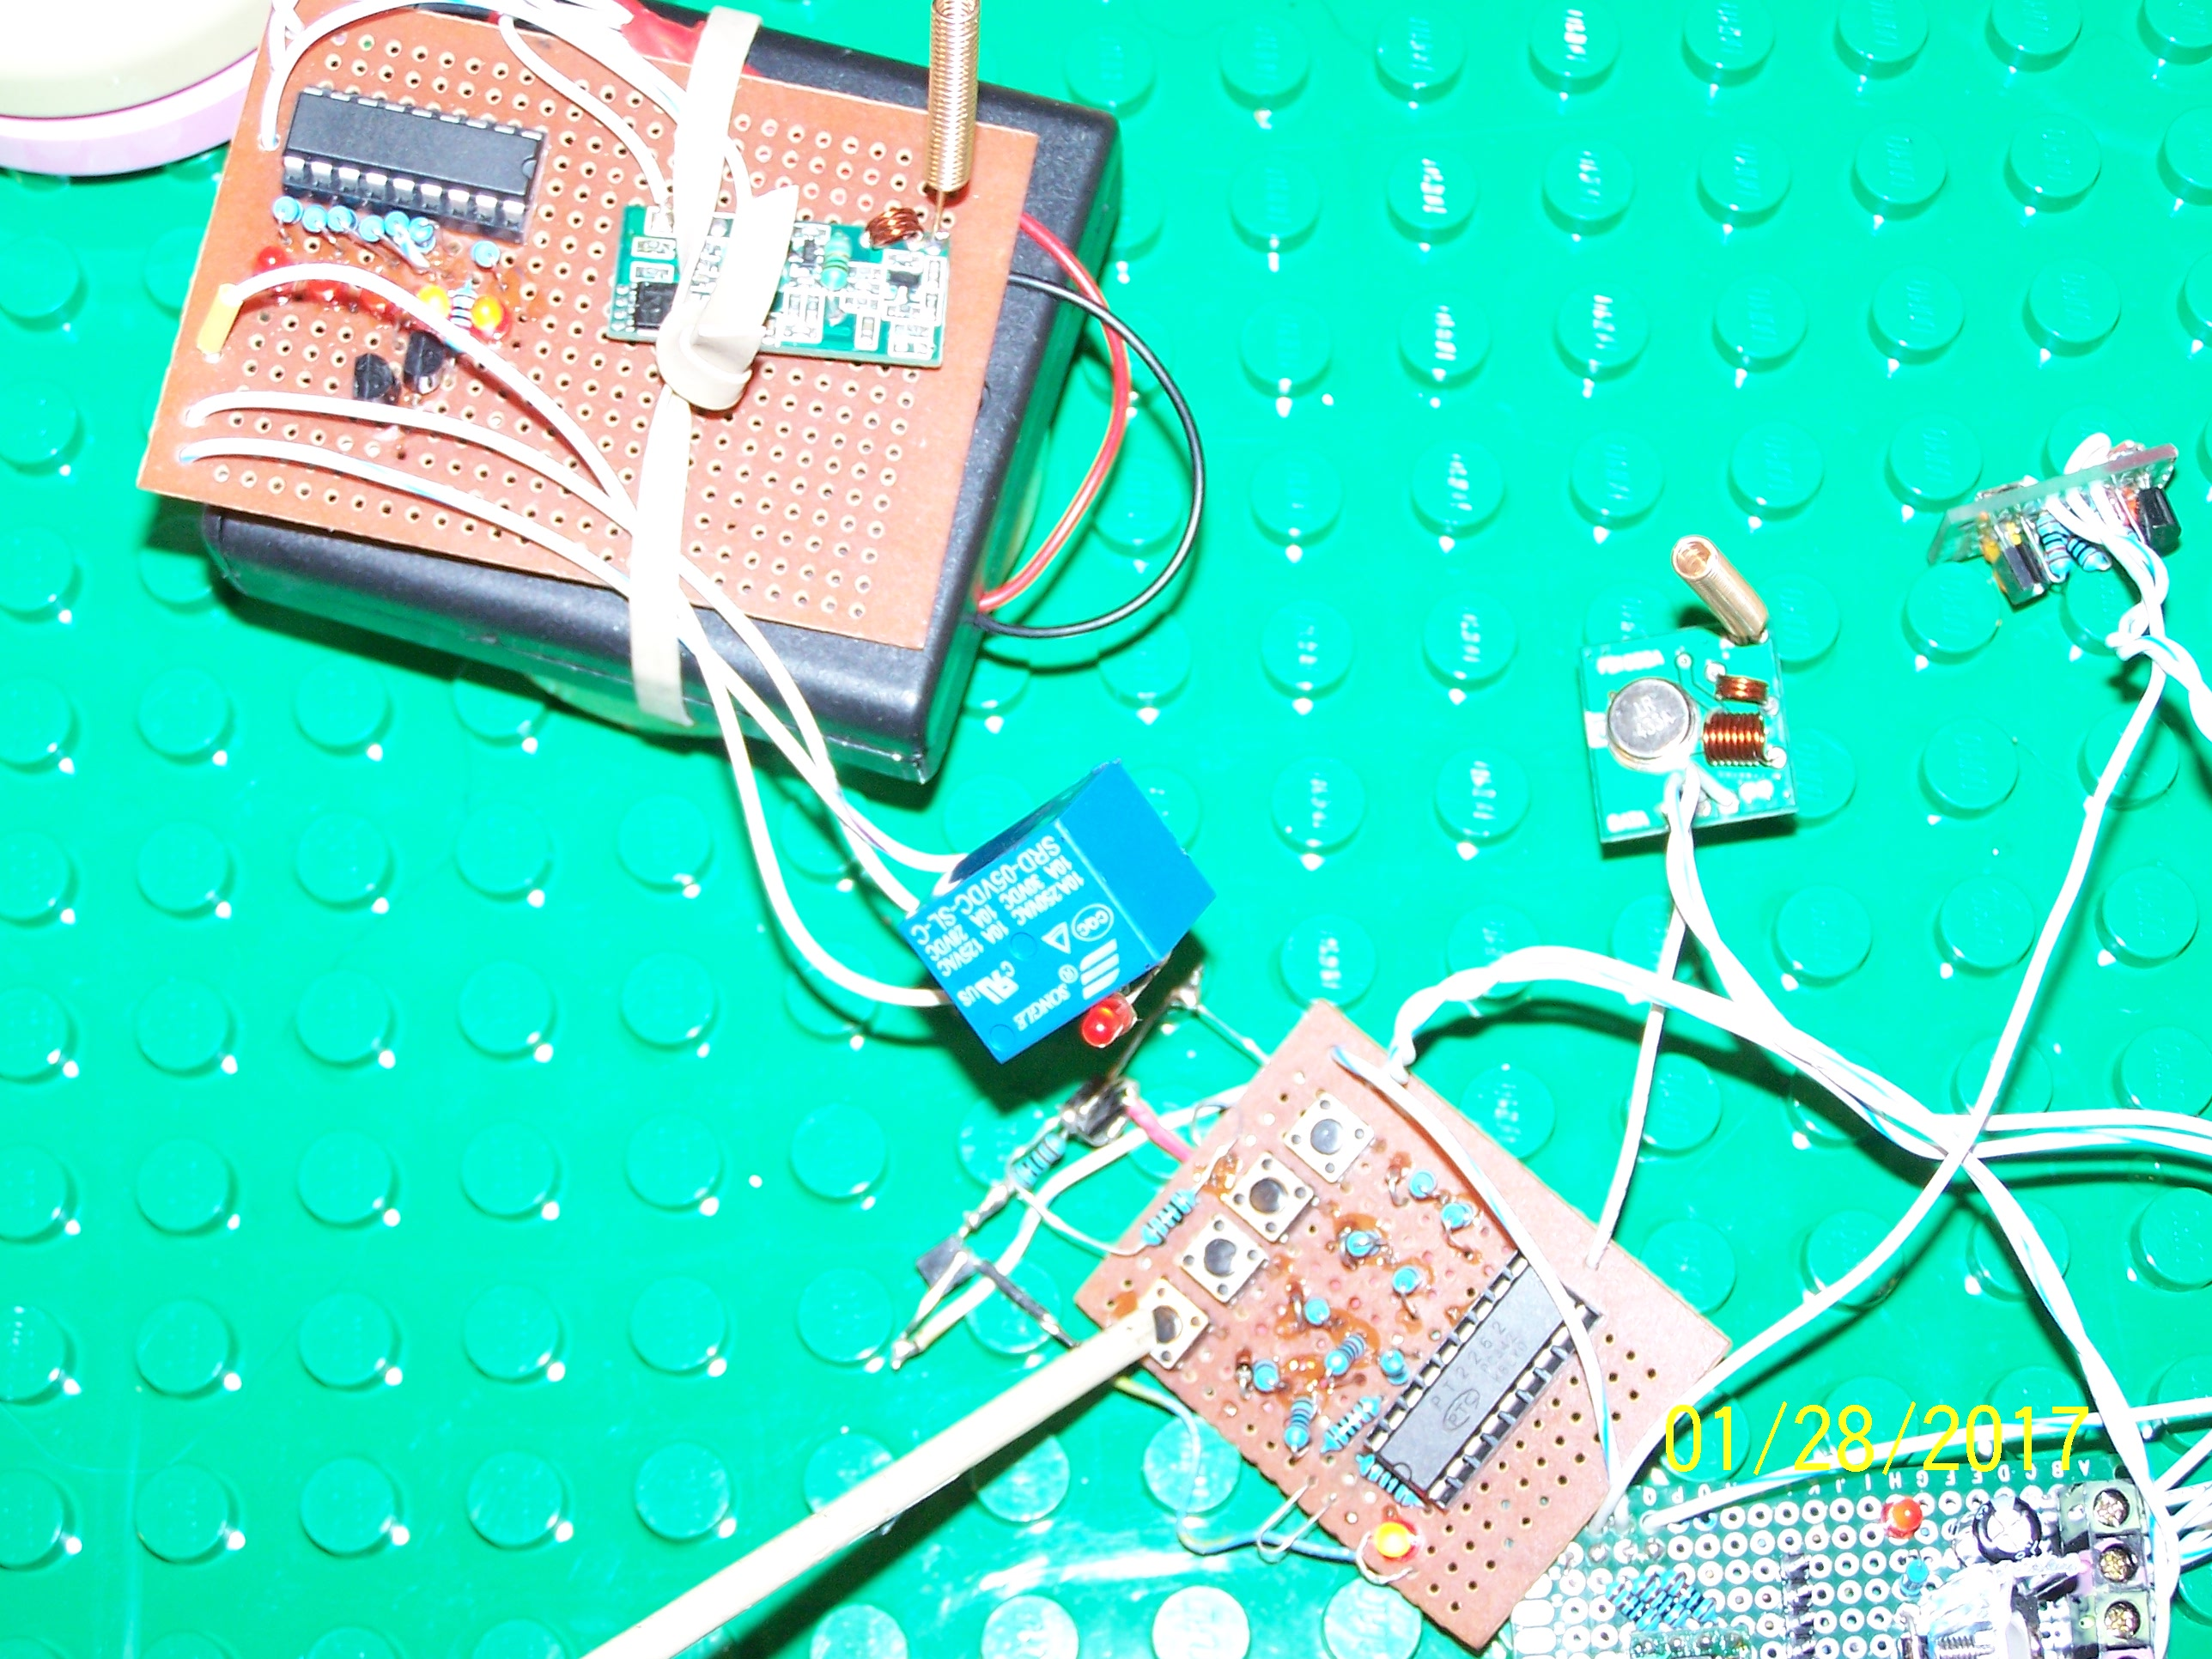
Current Project Progress
System Overview
Notes:
Kam

Slide 12
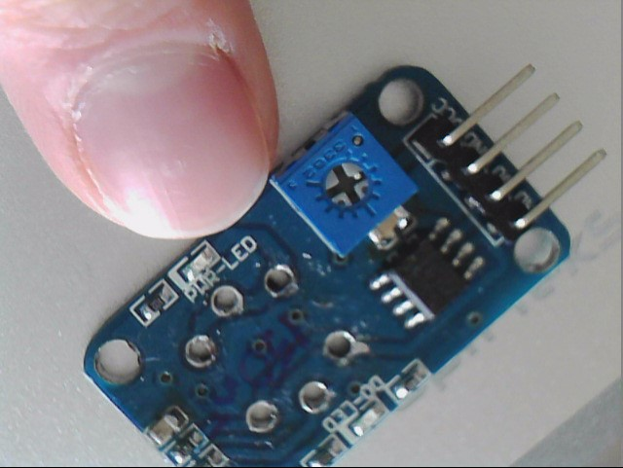
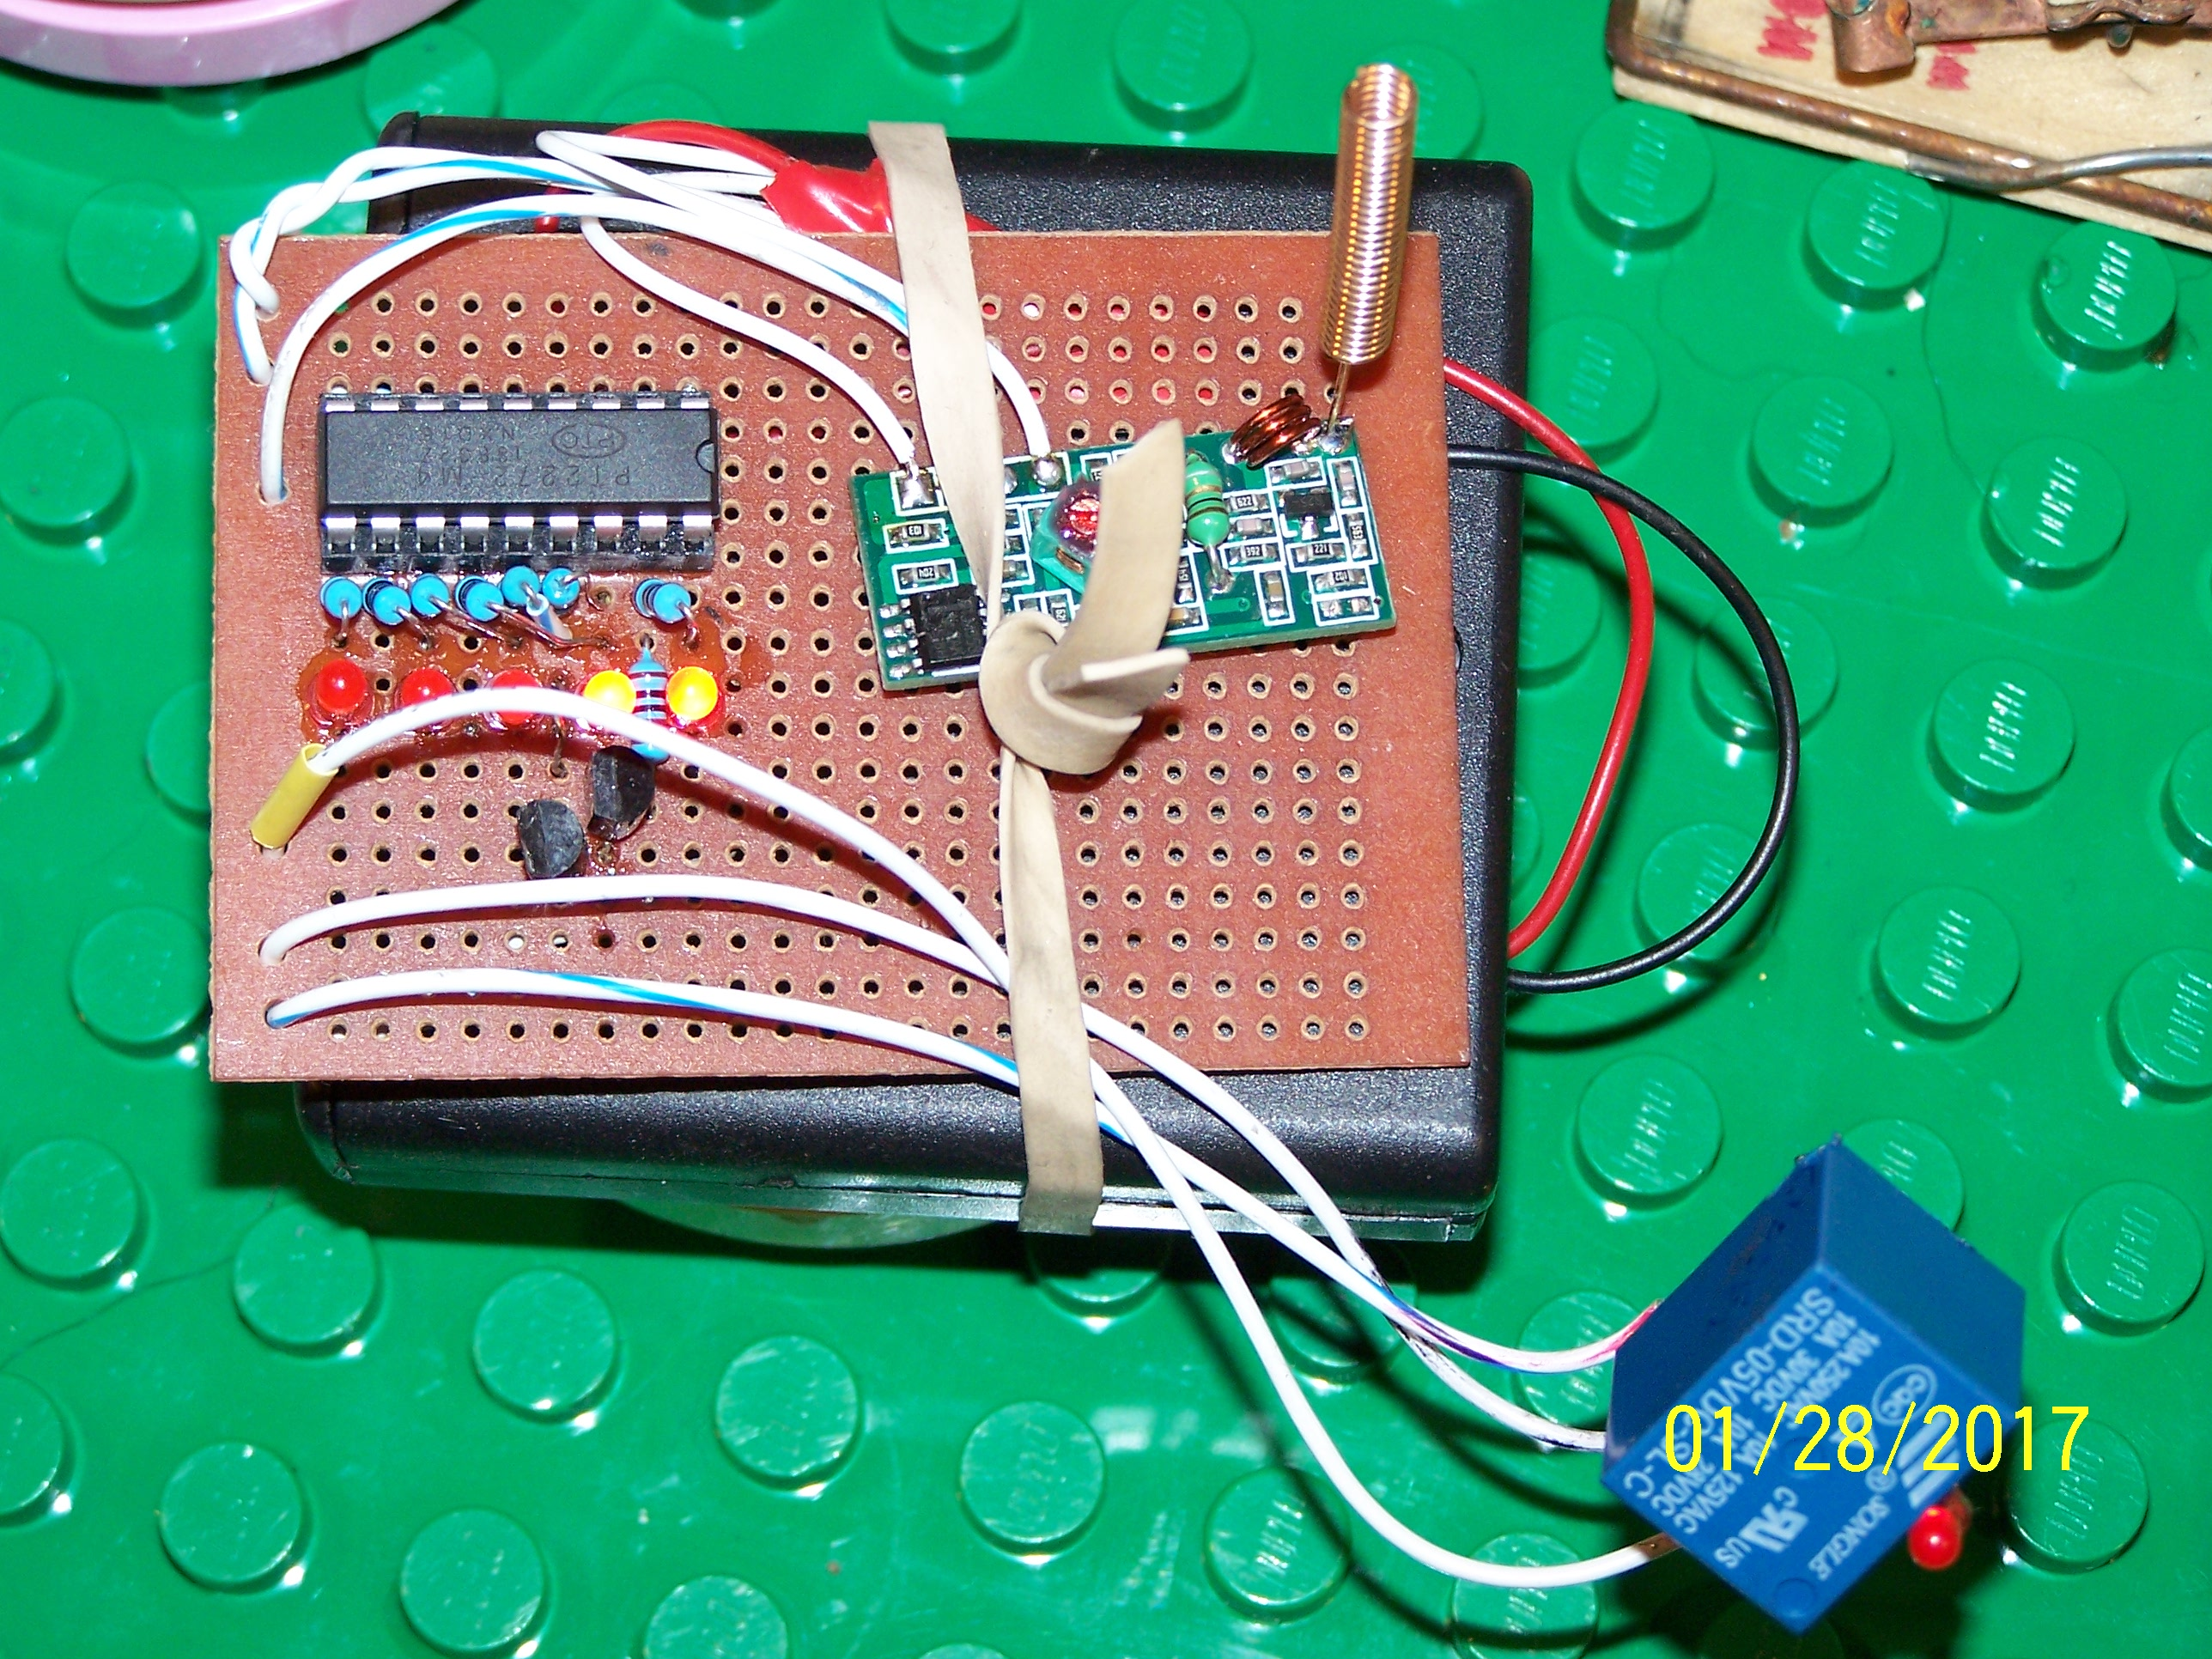
Current Project Progress
Gas Sensor Board
Actuator Receiver Board
Notes:
Kam

Slide 13
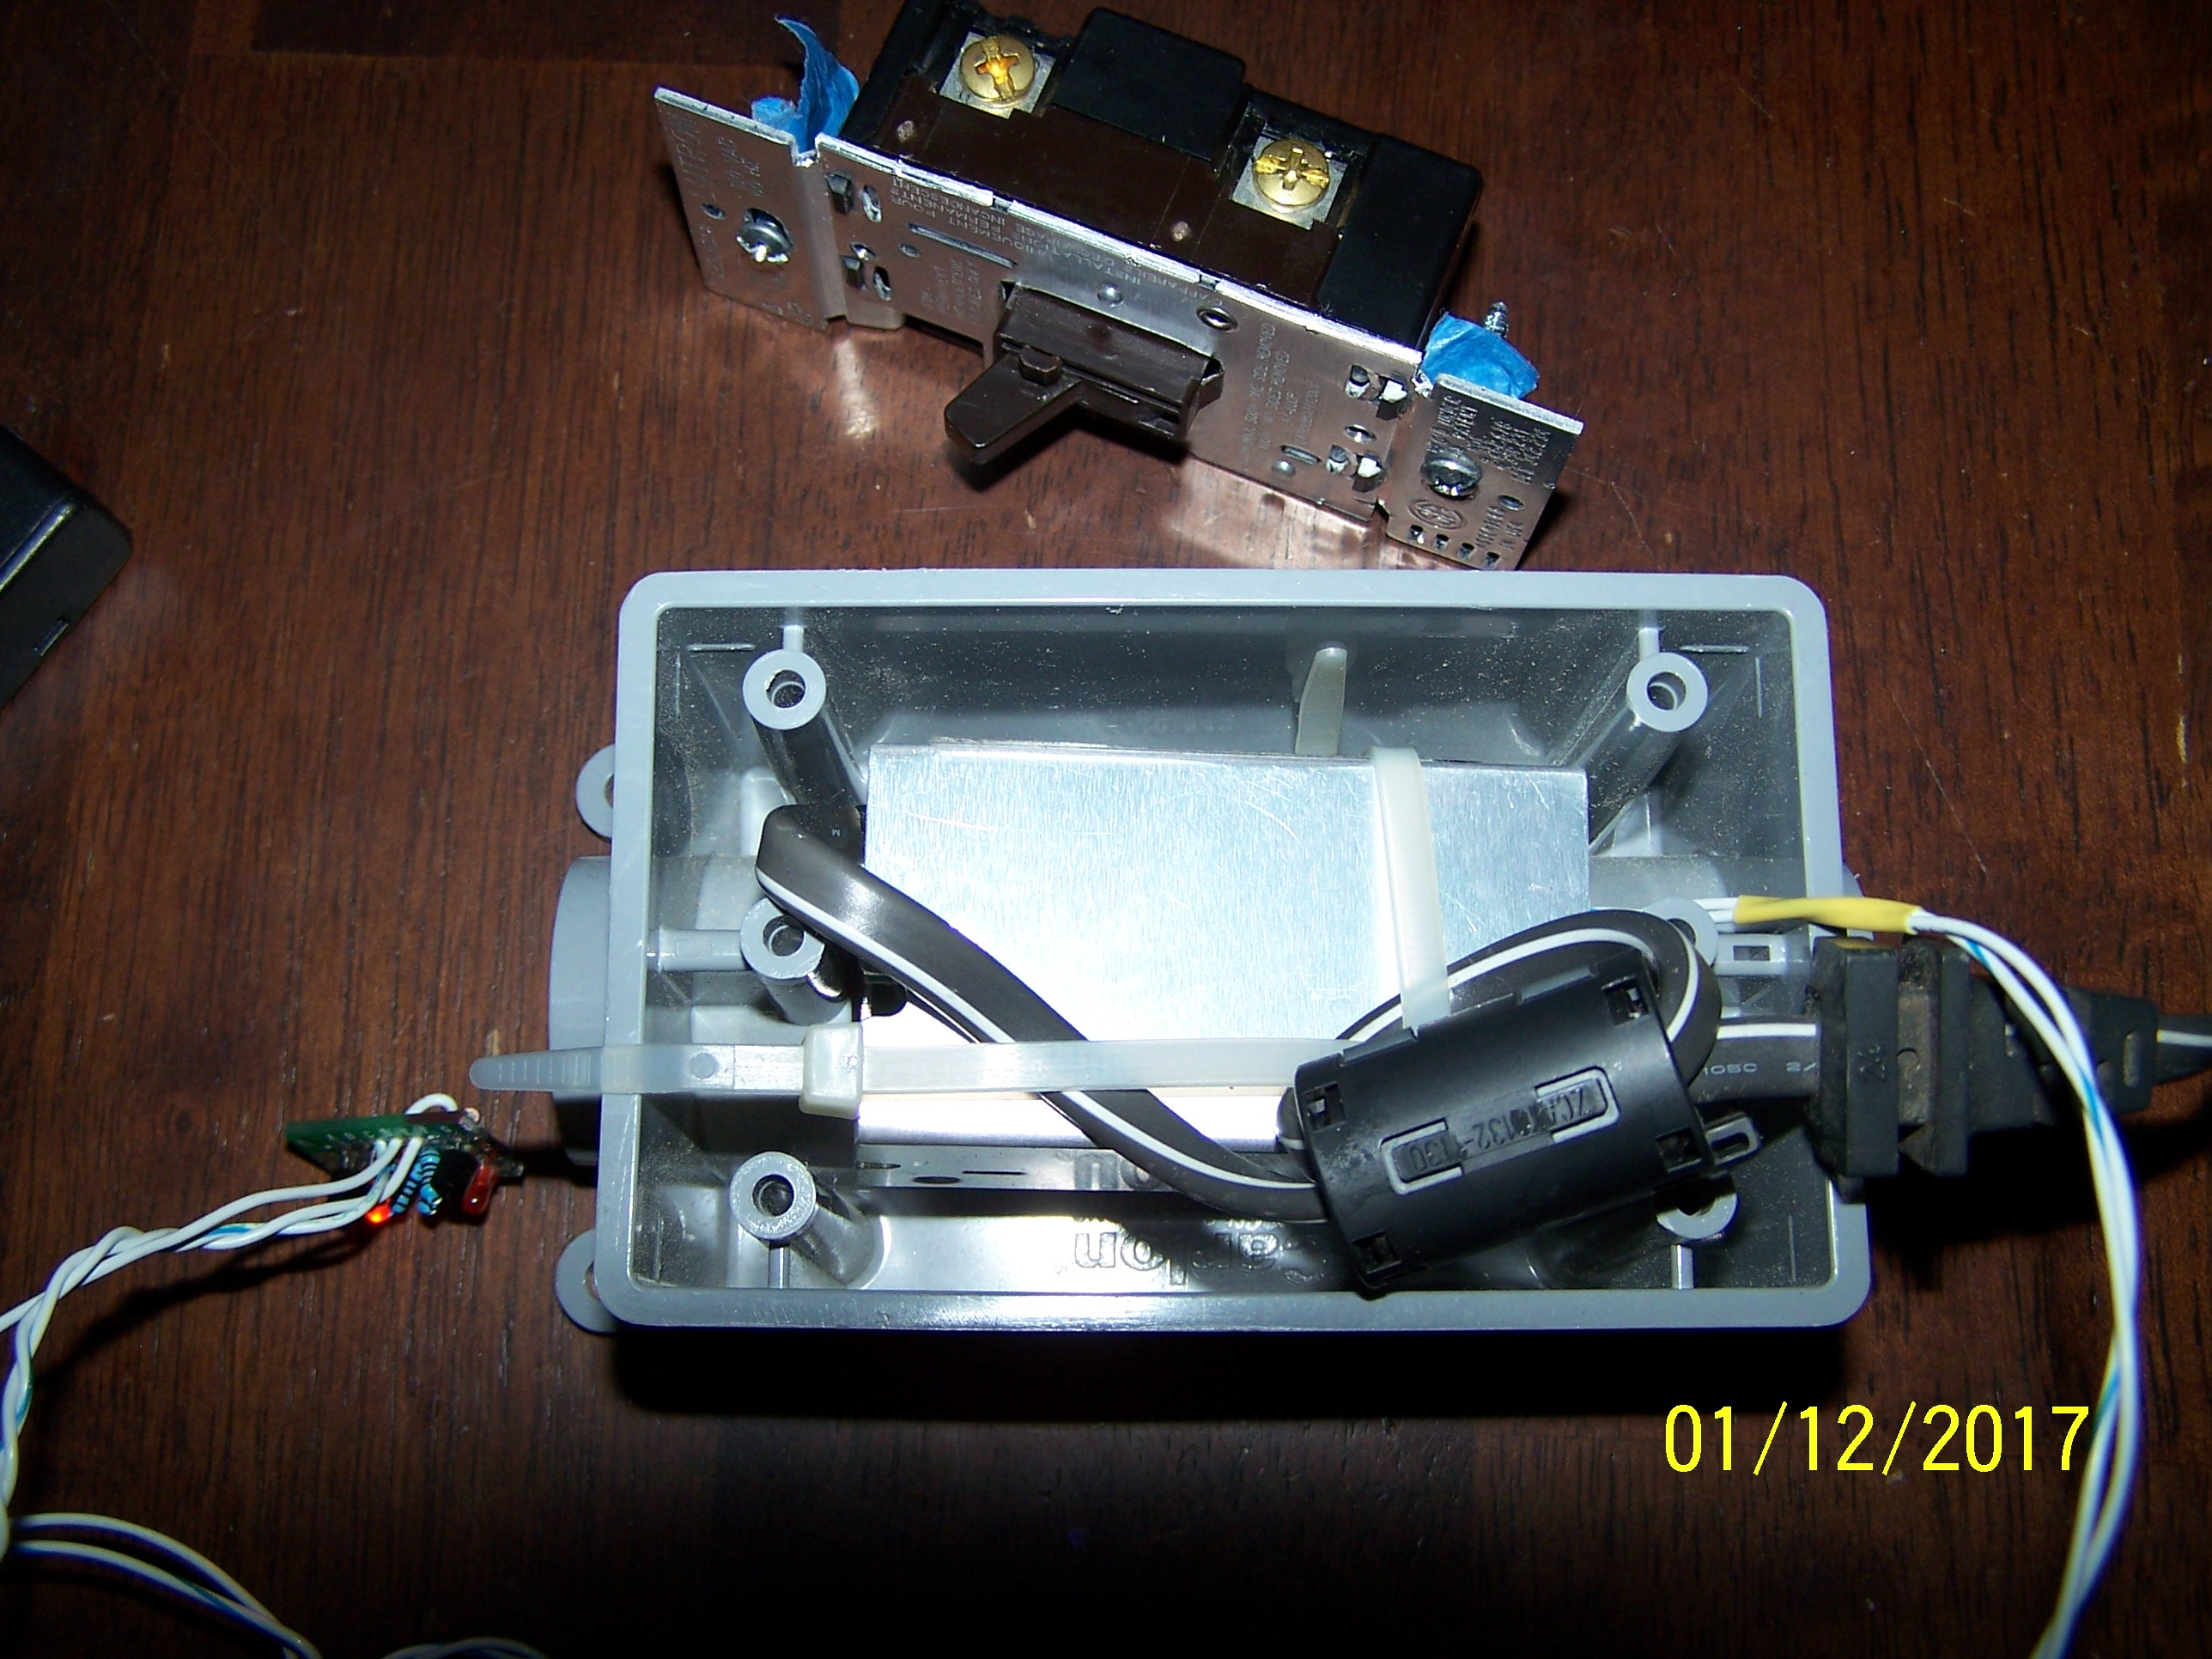
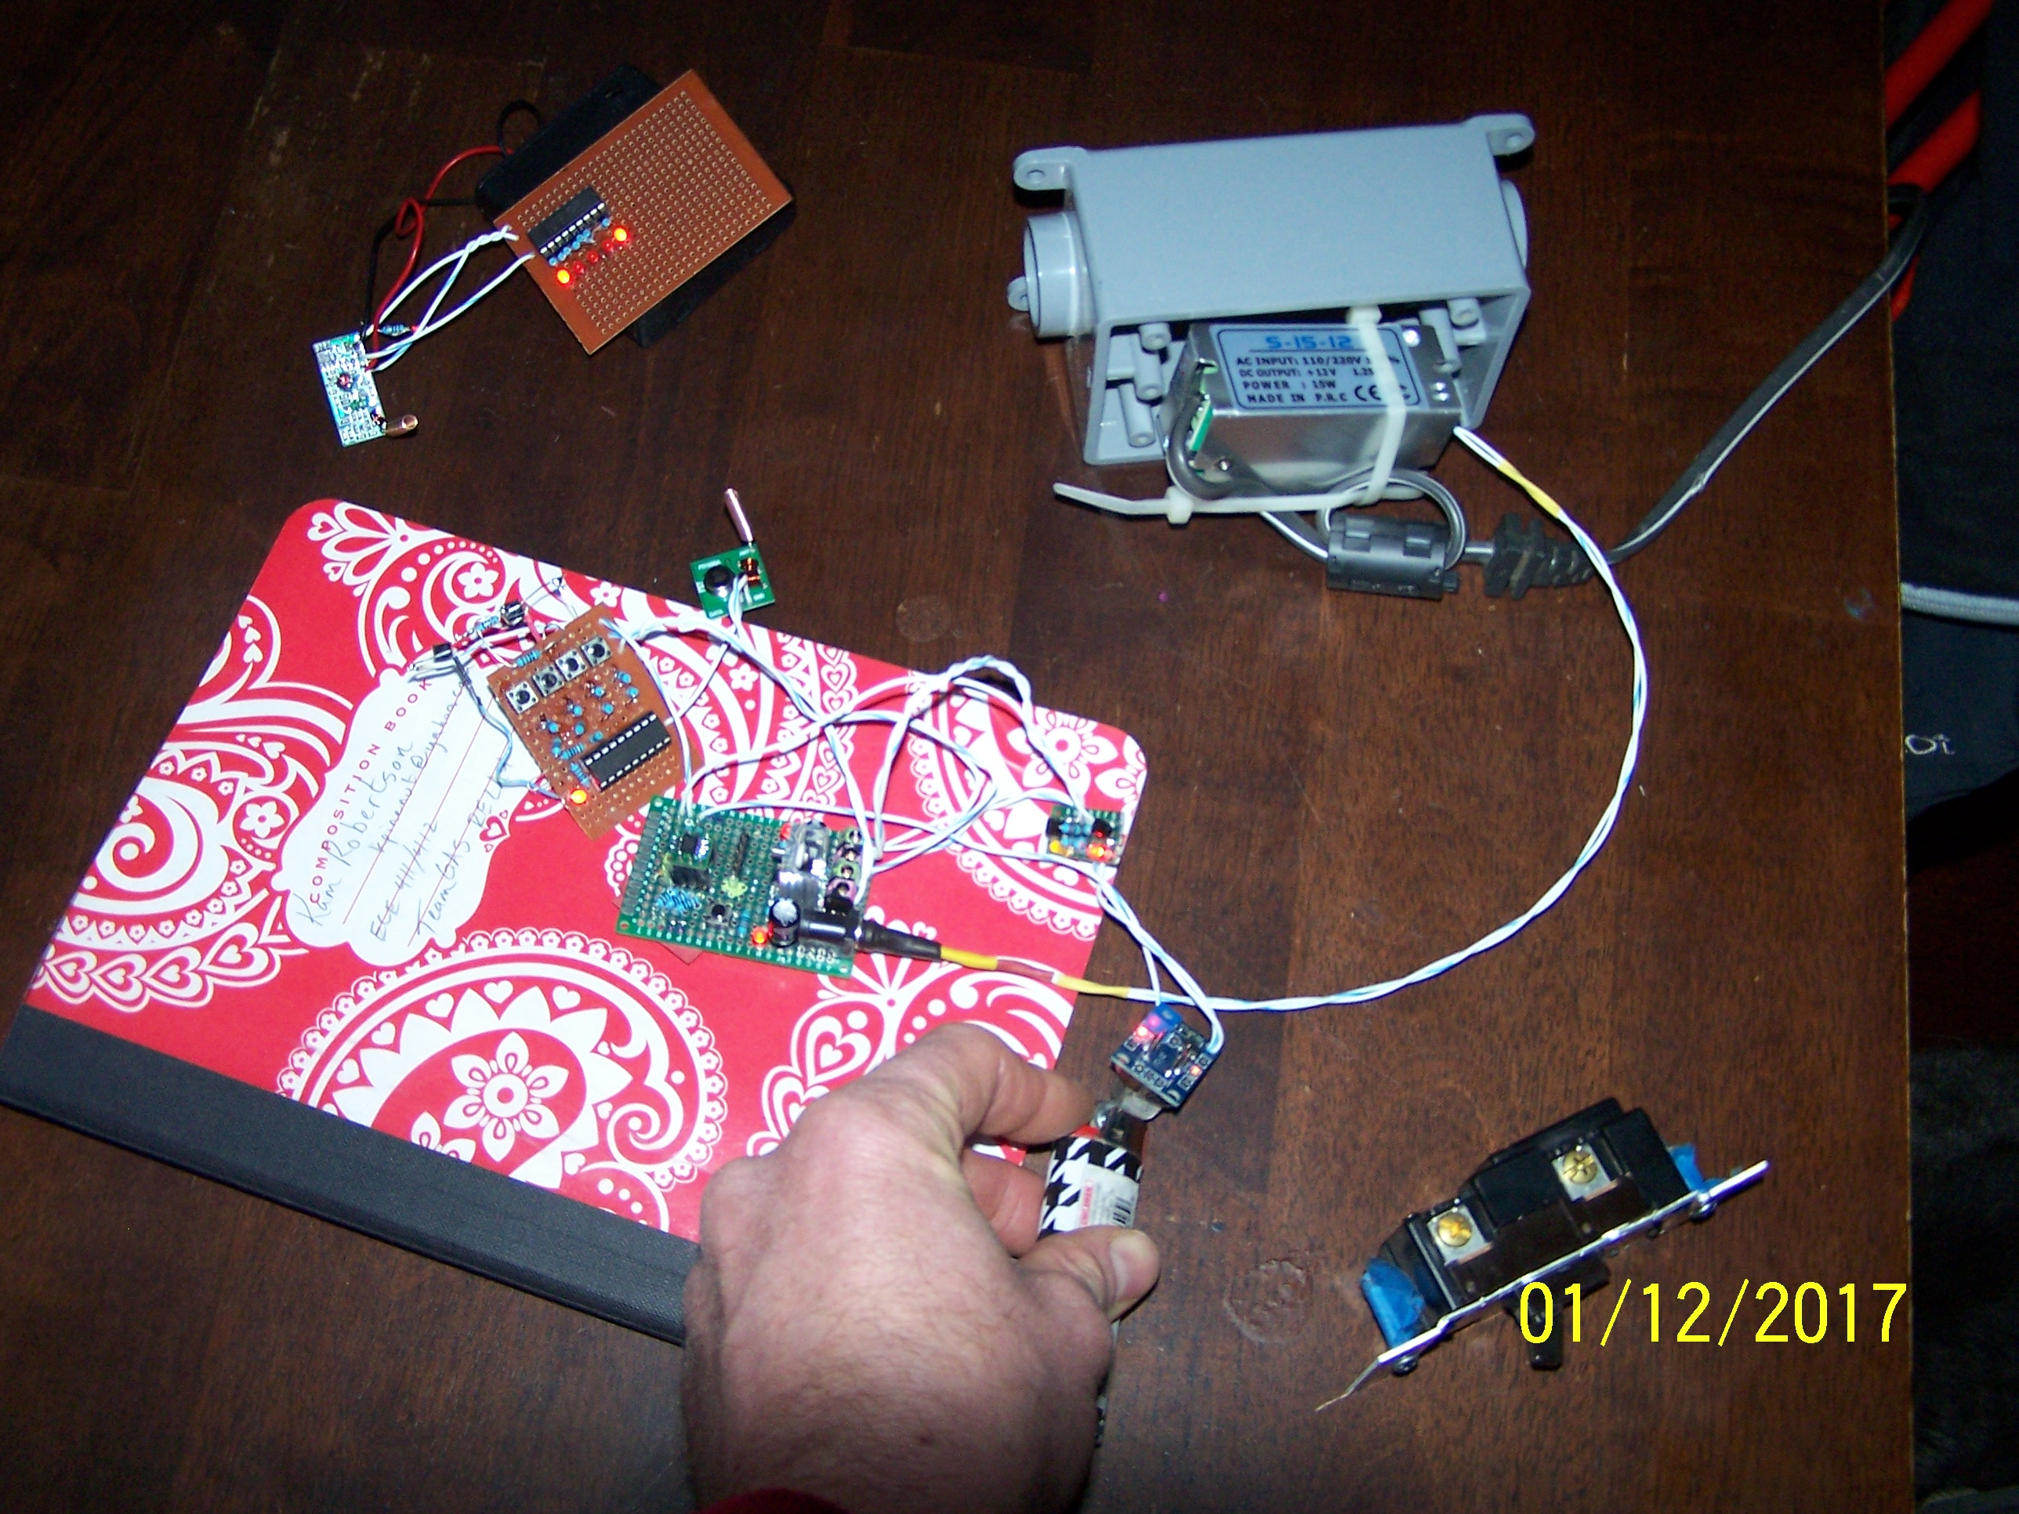
Current Project Progress
Enclosure
System Functioning
Notes:
Kam

